Slide 1
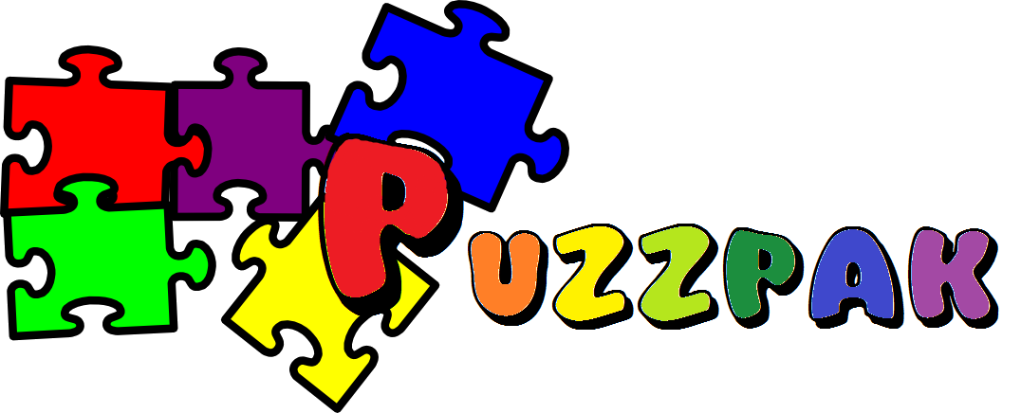
Applied Development Project, Spring 2017
Danielle Marcoullier

Slide 2
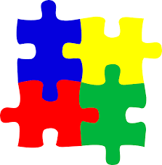
What is PuzzPak?
Game pack with well known games and a scoring system
  Allows people to challenge each other
Allows people to pick up an easy, but challenging game and play competitively
  Games aren't very complex, suitable for everyone.

Slide 3
What's Included
Hangman
Tik-Tak
Memory Tiles
  Easy and Hard difficulty
Leaderboard / Scoring system
Player Accounts

Slide 4
How Does it Work?

Slide 5
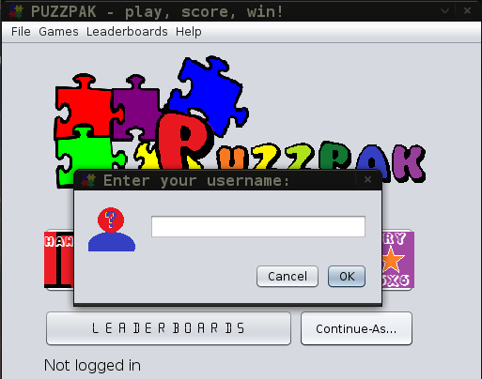
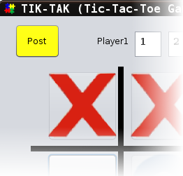
How Does it Work?
Interacting with the Database

Slide 6
How Does it Work?

Slide 7
Constraints & Processing
Username must be 15 or less chars, not null, and will be forced to be lowercase.
Each game processes scores before posting.
  Cannot be 0 or below 0
  3 rounds of Point based games required.
  Previous score for applicable game must be
  lower than the score just achieved.
High-Range bounds checking for scores are not needed, because it is impossible. 100% for point-based games will never occur. Each game will generate a score in a valid range.

